Slide 1


Weapon Detection using Artificial Intelligence and Deep Learning for Security Applications Levels
The second presentation

Slide 2
About us!
Group Members name :
Ajay Das K, Muhammed Safeer T, Najmudheen Kp,fathima C
Register Number:
CCV19CS002, CCV19CS016, CCV19CS018, CCV19CS006
Class :
S6 CSE
Area of seminar:
Ai Vision
Guide name :
Mrs. Sruthy
(Assistant Professor (CSE Dept) MGM College of Engineering )
Date Of Submission :15/07/2022

Slide 3

PROJECT PRESENTATION
Weapon Detection using Artificial Intelligence and Deep Learning for Security Applications Levels
WEAPON DETECTING DRONE WITH OBJECT DETECTION
PART 3 (100%)
PART ONE(50%)
PART TWO(80%)
PART ONE CONSIST OF
A MOVING ROVER DRONE
PART TWO CONSIST OF IMPLIMENTATION OF OBJECT DETECTION

Slide 4
About yolo v5
YOLOv5 is a recent release of the YOLO family of models.
YOLO was initially introduced as the first object detection model that combined bounding box prediction and object classification into a single end to end differentiable network.
It was written and is maintained in a framework called Darknet.
YOLOv5 is the first of the YOLO models to be written in the PyTorch framework and it is much more lightweight and easy to use.
That said, YOLOv5 did not make major architectural changes to the network in YOLOv4 and does not outperform YOLOv4 on a common benchmark, the COCO dataset.
Git hub repo: yolov5

Slide 5

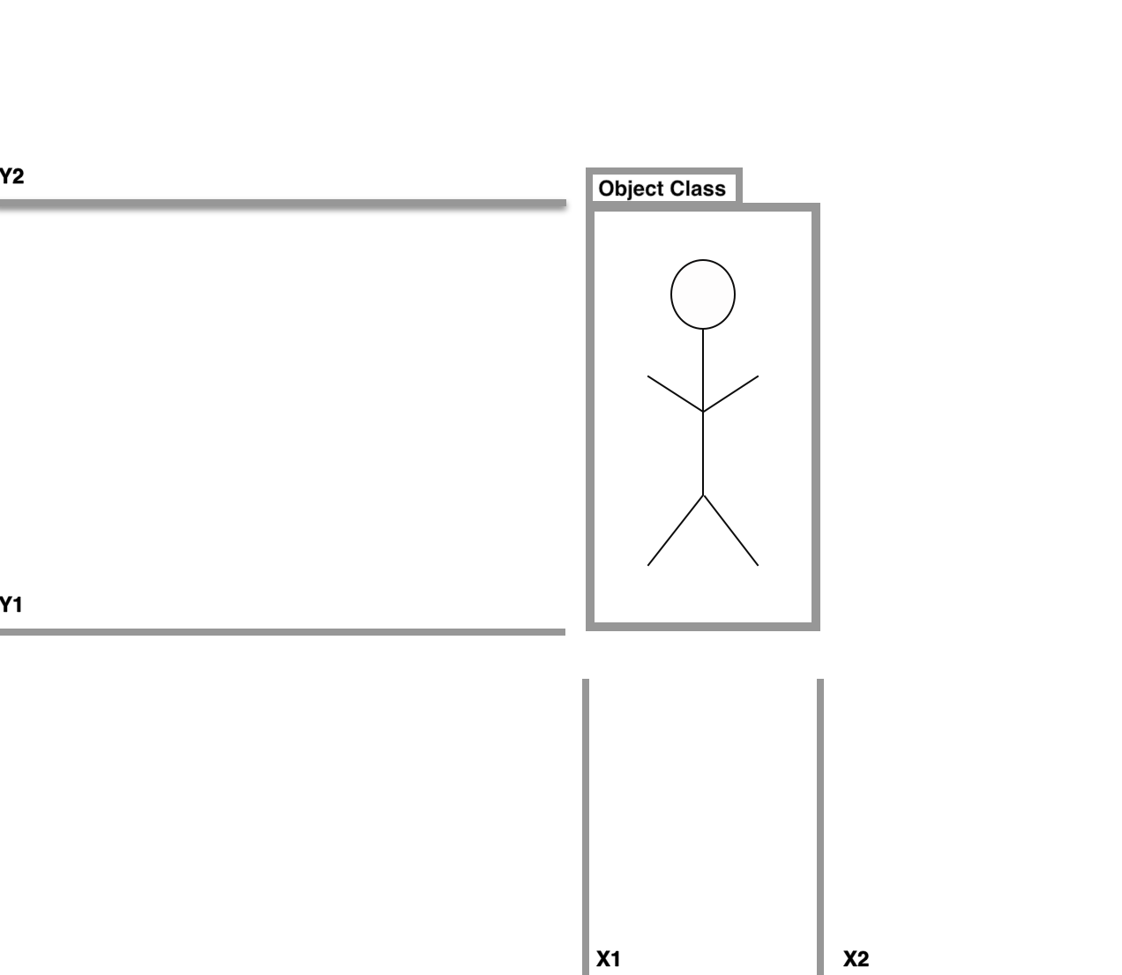
How yolov5 works
Our object detector model will separate the bounding box regression from object classifications in different areas of a connected network.

Slide 6
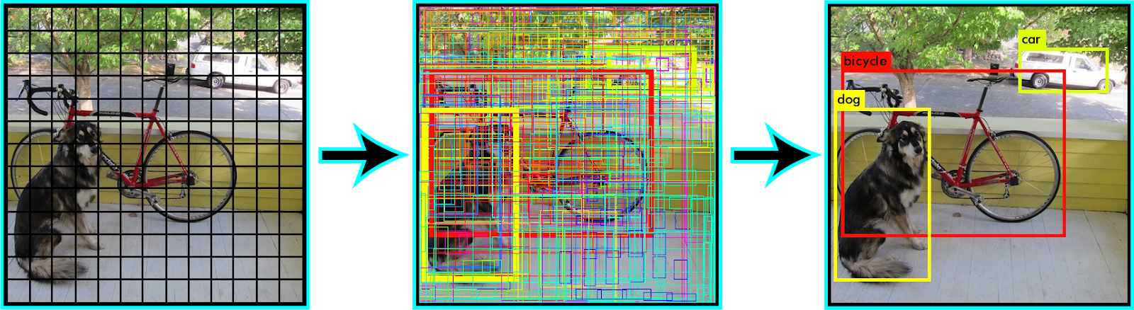
How yolov5 works
The YOLO algorithm works by dividing the image into N grids, each having an equal dimensional region of SxS. Each of these N grids is responsible for the detection and localization of the object it contains.

Slide 7

Collecting Our Training Images
narrowing your task to only identify 10 or less classes and collecting 50–100 images.
try to make sure that the number of objects in each class is evenly distributed.
choose objects that are distinguishable. A dataset of mostly cars and only a few jeeps for example will be difficult for your model to master.

Slide 8
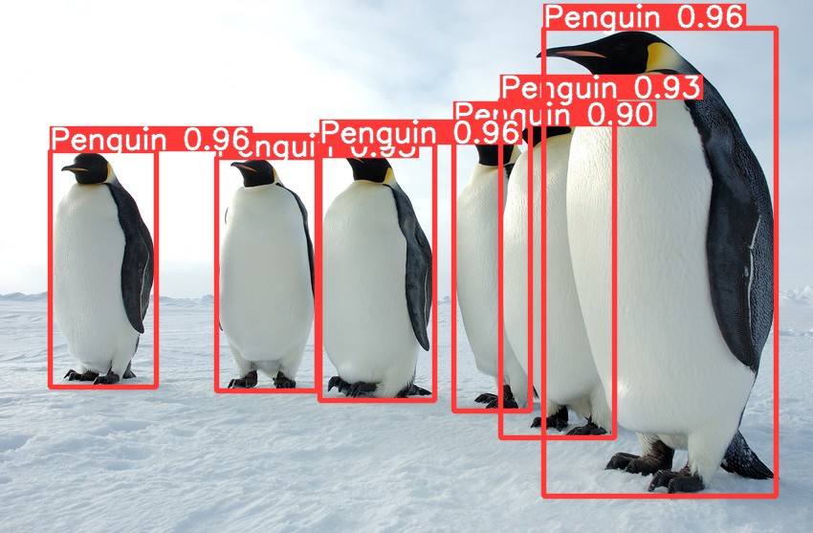
Result

Slide 9
Project status
Implimentation of rover drone
Project status 100%,moving object detection rover drone
50%
100%
0%
80%
Report
Searching for the base paper
Implimentation of yolov5 algorithm
Report submission

Slide 10


Conclusion
We implemented the yolo algorithm and it run successfully with out any error
We have gained an overview of object detection and the YOLO algorithm.
We have gone through the main reasons why the YOLO algorithm is important.
We have learned how the YOLO algorithm works. We have also gained an understanding of the main techniques used by YOLO to detect objects.
We have learned the real-life applications of YOLO.

Slide 11

Thank you. Any questions ?

